Slide 1
MINING FREQUENT PATTERNS,
ASSOCIATIONS, AND CORRELATIONS:
BASIC CONCEPTS AND METHODS

Slide 2
Imagine that you are a sales manager, and you are talking to a customer who recently bought a PC and a digital camera from the store. What should you recommend to her next?
Frequent patterns and association rules are the knowledge that you want to mine in such a scenario.

Slide 3
BASIC CONCEPTS
Frequent patterns are patterns (e.g., itemsets, or subsequences) that appear frequently in a data set.
For example, a set of items, such as milk and bread, that appear frequently together in a transaction data set is a frequent itemset.
A subsequence, such as buying first a PC, then a digital camera, and then a memory card, if it occurs frequently in a shopping history database, is a (frequent ) sequential pattern.
Frequent pattern mining searches for recurring relationships in a given data set.

Slide 4
MARKET BASKET ANALYSIS: A MOTIVATING EXAMPLE
A typical example of frequent itemset mining is market basket analysis. This process analyzes customer buying habits by finding associations between the different items that customers place in their “shopping baskets” .
The discovery of these associations can help retailers develop marketing strategies by gaining insight into which items are frequently purchased together by customers.
For instance, if customers are buying milk, how likely are they to also buy bread (and what kind of bread) on the same trip to the supermarket?

Slide 5
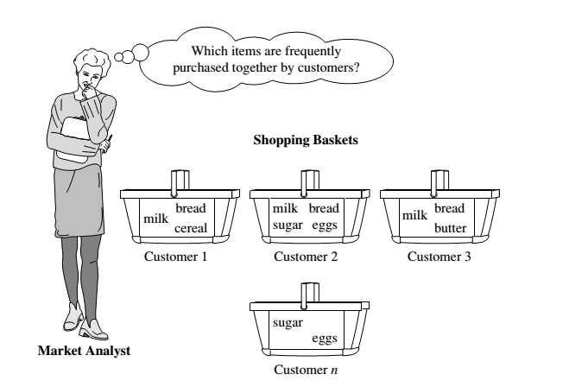

Slide 6
MARKET BASKET ANALYSIS: A MOTIVATING EXAMPLE
If customers who purchase computers also tend to buy antivirus software at the same time, then placing the hardware display close to the software display may help increase the sales of both items.
Market basket analysis can also help retailers plan which items to put on sale at reduced prices. If customers tend to purchase computers and printers together, then having a sale on printers may encourage the sale of printers as well as computers.

Slide 7
ASSOCIATION RULES
If we think of the universe as the set of items available at the store, then each item has a Boolean variable representing the presence or absence of that item.
Each basket can then be represented by a Boolean vector of values assigned to these variables.
The Boolean vectors can be analyzed for buying patterns that reflect items that are frequently associated or purchased together.
These patterns can be represented in the form of ASSOCIATION RULES.

Slide 8
ASSOCIATION RULES
For example, the information that customers who purchase computers also tend to buy antivirus software at the same time is represented in the following association rule:
A support of 2% for Rule means that 2% of all the transactions under analysis show that computer and antivirus software are purchased together.
A confidence of 60% means that 60% of the customers who purchased a computer also bought the software.

Slide 9
ASSOCIATION RULES
Typically, association rules are considered interesting if they satisfy both a minimum support threshold and a minimum confidence threshold. These thresholds can be a set by users or domain experts.

Slide 10
FREQUENT PATTERNS AND
ASSOCIATION RULES
Itemset X = {x₁, …, x_{k}}
Find all the rules X → Y with minimum support and confidence
  support, s, probability that a transaction contains X ∪ Y.
  confidence, c, conditional probability that a transaction having X also contains Y.
Transaction-id | Items bought
10 | A, B, D
20 | A, C, D
30 | A, D, E
40 | B, E, F
50 | B, C, D, E, F
Customer
buys both
Customer
buys Bread
Let sup_{min} = 50%, conf_{min} = 50%
Freq. Pat.: {A:3, B:3, D:4, E:3, AD:3}
Association rules:
  A → D (60%, 100%)
  D → A (60%, 75%)
Customer
buys Milk

Slide 11

FREQUENT PATTERNS AND
ASSOCIATION RULES
Rules that satisfy both a minimum support threshold (min_sup) and a minimum confidence threshold (min_conf ) are called strong.
A set of items is referred to as an itemset. An itemset that contains k items is a k-itemset. The set {computer, antivirus software} is a 2-itemset.
The occurrence frequency of an itemset is the number of transactions that contain the itemset.
This is also known, simply, as the frequency, support count, or count of the itemset.

Slide 12

FREQUENT PATTERNS AND
ASSOCIATION RULES
In general, association rule mining can be viewed as a two-step process:
Find all frequent itemsets: By definition, each of these itemsets will occur at least as frequently as a predetermined minimum support count, min sup.
Generate strong association rules from the frequent itemsets: By definition, these rules must satisfy minimum support and minimum confidence.

